Slide 1
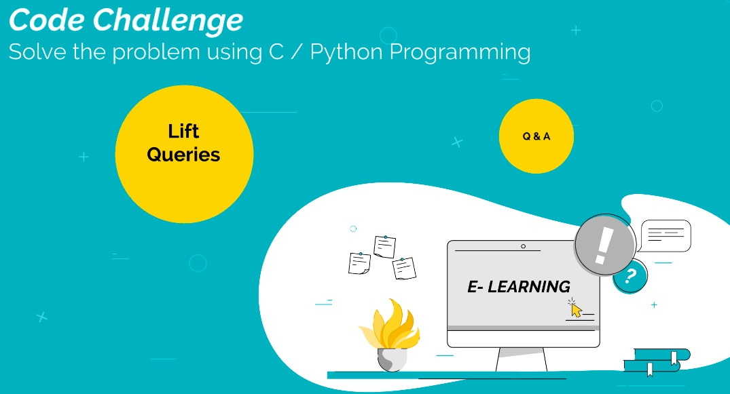
Code Challenge: THE MINION GAME
Solve using Python Script

Slide 2
Lift queries
Rules
There are 7 floors in APARTMENT BUILDING and only 2 lifts.
Initially Lift A is at the ground floor and Lift B at the top floor.
Whenever someone calls the lift from N th floor, the lift closest to that floor comes to pick him up.
If both the lifts are at equidistant from the N th floor, then the lift from the lower floor comes up.

Slide 3
INPUT
First line contains a integer T denoting the number of test cases.
Next T lines contains a single integer N denoting the floor from which lift is called.
OUTPUT
Output T lines containing one character "A" if the first lift goes to N th floor or "B" for the second lift.

Slide 4
SAMPLE INPUT 1
2
3
5
SAMPLE OUTPUT 1
A
A
SAMPLE INPUT 2
2
7
2
SAMPLE OUTPUT 2
B
A

Slide 5
C CODE
#include<stdio.h>
#include<stdlib.h>
int main()
{
int test, call, a=0, b=7, p, q;
scanf("%d",&test);
while(test--)
{
scanf("%d",&call);
p=abs(a- call);
q=abs(b- call); if(p<=q)
{
printf("A\n");
a=call; }
else
{
printf("B\n");
b=call;
}
}
return 0;
}

Slide 6
#include <iostream>
using namespace std;
int main()
{
int test,call;
int a=0,b=7;
cin>>test;
while(test--)
{
cin>>call;
if(abs(call-a) <= abs(call-b))
{
cout<<"A\n";
a=call;
}
else
{
cout<<"B\n";
b=call;
}
}
}
C++ CODE

Slide 7
Python CODE
a=0
b=7
for i in range(0,int(input())):
call = int(input())
if(abs(call-a)<=abs(call-b)):
print('A')
A=call
else:
print('B')
B=call

Slide 8
THANK
YOU

